Slide 1

FEDERATED LEARNING:
PRIVACY AT THE CORE OF MACHINE LEARNING
Presented by:
Hafsa Y
NSS College Of Engineering Palakkad
Guide:
Professor:Dr.Deepak Mishra
Department:Avionics
Indian Institute Of Space Science And Technology

Slide 2

Can data live at edge?
On-device inference means running a machine learning model's prediction (inference) directly on a local device—like a smartphone, IoT sensor, drone, or embedded system—without sending data to the cloud.
on device inference offers:
Improved latency
works offline
better battery life
privacy advantage
Edge models are:
Not generalizable to other users
Limited in data → poor learning
Incapable of coordination, so no shared intelligence

Slide 3


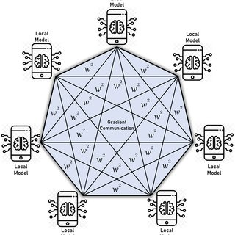

Federated Learning
Privacy Preservation
No raw data sharing: Only model updates (like gradients or weights) are shared, not the actual data.
Data stays on device: Helps comply with privacy laws like GDPR and HIPAA.
Decentralized Learning
Learning happens locally on each client/device.
No need for a centralized dataset — very useful when data is distributed across devices (e.g., phones, hospitals, vehicles).
Personalized & Scalable AI
Models can adapt locally to each user/device.
Enables scalability across millions of devices with heterogeneous (diverse) data.

Slide 4
How Federated Learning Works?
we need to know the device having threshold greater than 70 degree
Threshold Fraction
(an input)
>70 degree
sensor_reading
(an input)
max_temp
device not selected for this round of computation

Slide 5
Emphemeral report
never persist per device report
>
1
Federated aggregation
combine reports from multiple devices
<
0
output fraction with
greater than threshold
sensor_reading
device not selected for this round of computation

Slide 6
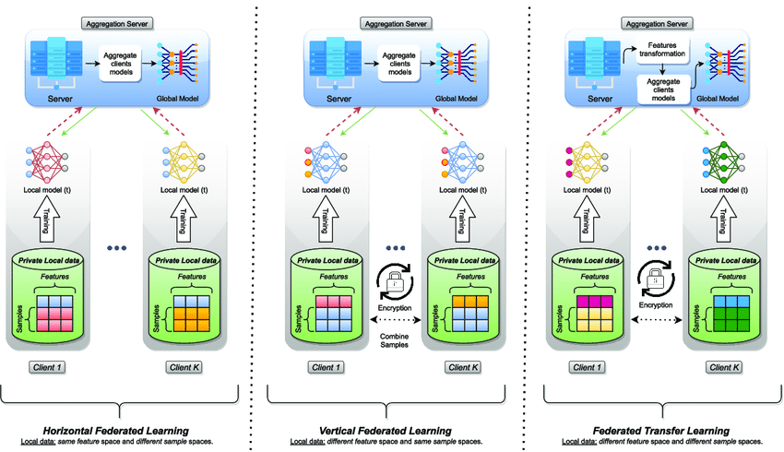


Different Types Of FL
HFL
VFL
FTL
A mobile game app in India and a health app in the US — very different data, but both can learn user engagement patterns.

Slide 7


Challenges In Federated Learning
Data Heterogeneity
Problem: Devices have different types of data (Non-IID).
Real-World Impact: Leads to a poor global model.
Solution: Use custom aggregation methods like FedProx.
System Heterogeneity
📱💻🖥️
Problem: Devices vary in compute power, battery, and availability.
Real-World Impact: Unstable or partial client participation.
Solution: Use adaptive or flexible training protocols (e.g., asynchronous FL).
Scalability Issues
Problem: Too many devices participating.
Real-World Impact: Server overload and longer training time.
Solution: Use client sampling, clustering.

Slide 8
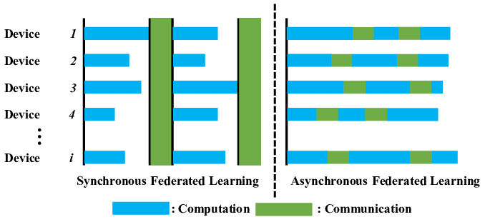
ASYNCHRONOUS FL AND SYNCHRONOUS FL
SYNCHRONOUS FL
[Client A]──┐
[Client B]──┤ → Server waits → Aggregate → New model
[Client C]──┘
ASYNCHRONOUS FL
Client A → Server (immediate update)
Client B → Server (later update)
Client C → Server (even later update)
Asynchronous FL | Synchronous FL
Prone to failure if clients are slow or drop out | Tolerant to client delays or dropouts
Clients update the global model whenever they finish
Clients update the global model at the same time

Slide 9
Is Federated Learning Truly Private?
“Even without raw data, attackers can reconstruct what you typed just from gradients!”
— Deep Leakage from Gradients, Zhu et al., 2019

Slide 10
Step-by-Step Attack Procedure
Receives the gradient from the client:
∇L(w,x,y)
Initializes random guess x', y' (fake input & label)
Computes gradient from the guess:
∇L(w,x′,y′)
Minimizes the difference between the real and fake gradients:
min⁡x′,y’||∇L(w,x′,y′)−∇L(w,x,y)||
Update your guess (x′, y′) using gradient descent:
x′ ← x′ − η ⋅ ∇ₓ′ Loss
y′ ← y′ − η ⋅ ∇ᵧ′ Loss

Slide 11
How to Defend Against Gradient Leakage?
Differential Privacy – Noise for protection
Secure Aggregation – Encrypt then combine
Homomorphic Encryption – Compute on locked data
Split Learning – Send only brainwaves (activations!)

Slide 12
Secure Aggregation
+
= 0
Secure aggregation is a privacy-preserving technique used in federated learning to ensure that individual device updates (gradients/weights) remain secret, even from the central server that aggregates them.
Attackers (or even the central server) could potentially reconstruct sensitive data from just the model updates.

Slide 13
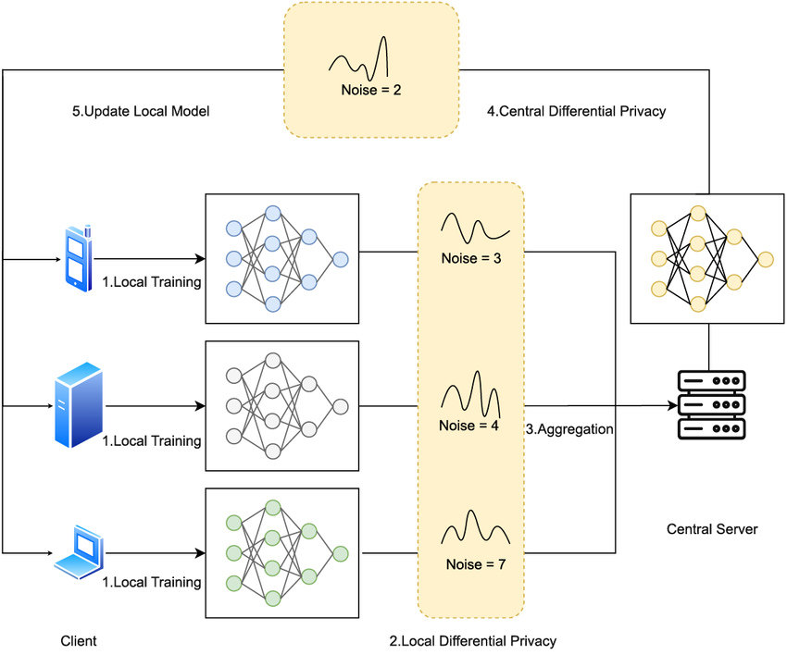
Differential Privacy
Before sending the model update to the server:
The device adds random noise (usually Gaussian) to the model parameters or gradients.
This hides individual contributions.
LOCAL DP
CENTRAL DP
User Device
Add Noise
User Device
Send Updates
Server Gets Noisy Data
Server Recieves True update add DP
Choudhury et al. – Differential Privacy-enabled Federated Learning for Sensitive Health Data

Slide 14
The client computes the gradient
Then adds random noise to it (usually Gaussian or Laplace)
Sends the noisy gradient to the server
Sends the noisy gradient to the server
Sent:∇L(w,x,y)+Noise
It aggregates them from many clients
Due to law of large numbers, much of the noise cancels out
So the global model still learns, but individual privacy is protected

Slide 15
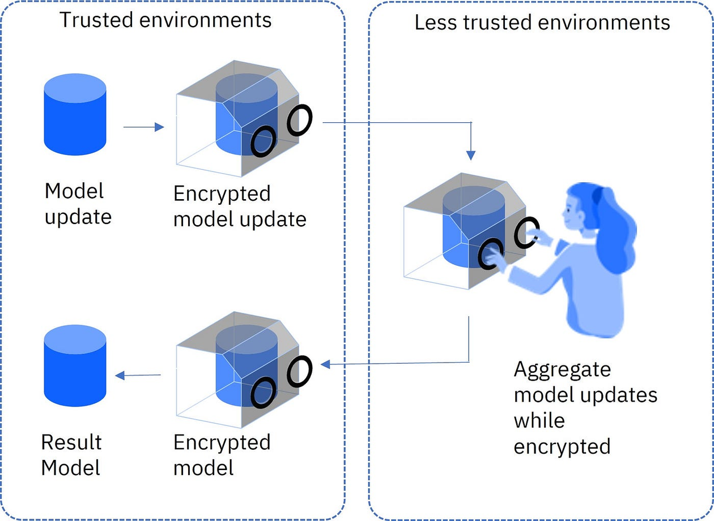
Homomorphic Encryption
Homomorphic Encryption (HE) enables computations to be carried out directly on encrypted data, without the need to decrypt it first.
Security: Data remains encrypted at all times.
Accuracy: Computation results are correct and unchanged.
Privacy: Prevents data leaks during processing.
Use Cases: Medical data analysis, secure cloud AI, privacy-preserving ML.
FedML-HE: An Efficient Homomorphic-Encryption-Based Privacy-Preserving Federated Learning System-Weizhao Jin et al.

Slide 16
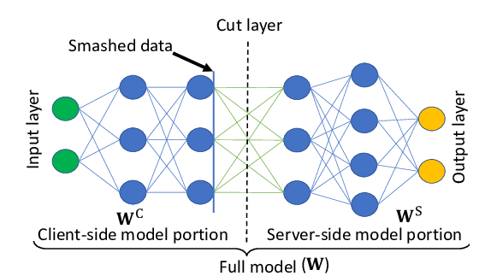
Split Learning
Model is split between client and server — the client trains the initial layers, and the server trains the rest.
Only activations (not raw data) are sent from client to server, preserving data privacy.
Ideal for low-resource devices like mobile phones and hospitals with privacy constraints.
Supports collaborative training without sharing sensitive data like images or health records.

Slide 17
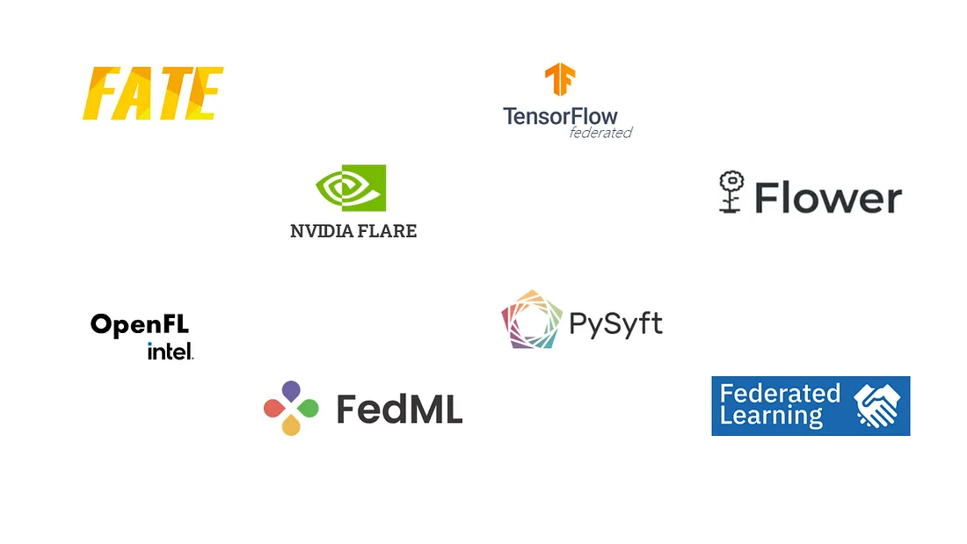
FEDERATED LEARNING FRAME WORK IN PYTHON

Slide 18
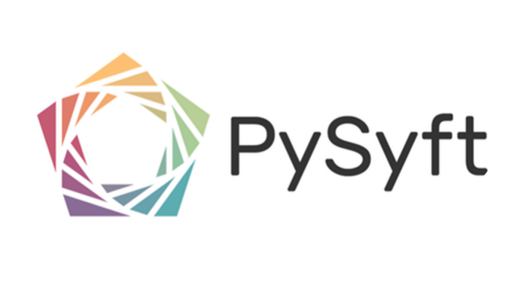
Use: Privacy-preserving machine learning
Features:
Supports federated learning, differential privacy, and secure computation
Works with PyTorch and TensorFlow
From: OpenMined
GitHub: github.com/OpenMined/PySyft

Slide 19

Use: Scalable, production-ready federated learning
Features:
Easy to set up FL with custom models
Supports PyTorch, TensorFlow, and JAX
Great for simulation and real-world deployment
GitHub: github.com/adap/flower

Slide 20

Use: Federated learning with TensorFlow
Features:
Built on top of TensorFlow
Designed for simulating FL on distributed data Integrates with DP-SGD
From: Google
🌐 GitHub: https://github.com/google-parfait/tensorflow-federated

Slide 21

Use: Research and production FL
Features:
Cross-device and cross-silo FL
Supports IoT, edge devices, and cloud simulation
Built-in algorithms like FedAvg, FedProx, FedNova
GitHub: github.com/FedML-AI/FedML

Slide 22
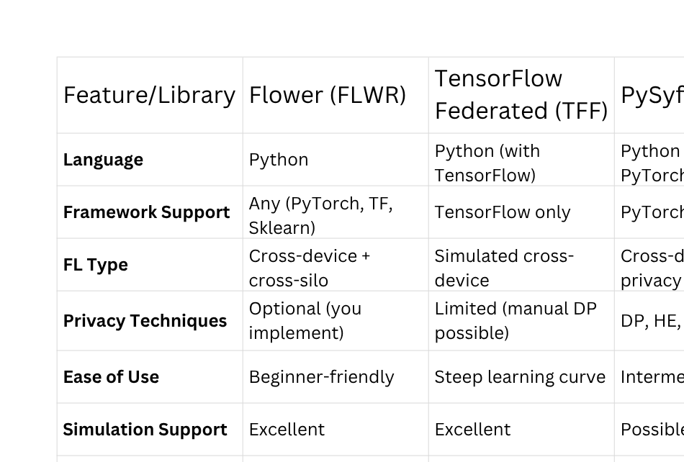

Slide 23
MATHEMATICS IN FEDERATED LEARNING
Federated Learning aims to optimize a global model using data distributed across multiple clients, without moving raw data to a central server.
1.Define Global Loss Function
F(w) = ∑ₖ (nₖ / n) * Fₖ(w)
F(w) → Global objective function (to be minimized)
Fₖ(w) → Local objective (loss) on client k
nₖ → Number of data samples on client k
n → Total data samples across all clients (n = ∑ₖ nₖ)
w → Model parameters (weights)

Slide 24
2. Local Loss Function (Client k)
Fₖ(w) = (1 / nₖ) * ∑ᵢ ℓ(f_w(xᵢᵏ), yᵢᵏ)
ℓ(...) → Loss function (e.g., cross-entropy, MSE)
f_w(...) → Model prediction using weights w
xᵢᵏ, yᵢᵏ → Data point and label on client k
3. Local Training Step (SGD)
wₖ = wₜ - η * ∇Fₖ(wₜ)
wₜ → Global model weights at round t
wₖ → Locally updated weights on client k
η → Learning rate
∇Fₖ(wₜ) → Gradient of local loss at client k

Slide 25
4. Server Aggregation (FedAvg)
wₜ₊₁ = ∑ₖ (nₖ / n) * wₖ
wₜ₊₁ → Updated global model
wₖ → local model weights from client k
nₖ / n →nk​: The number of data samples on client k.
n= The total number of data samples across all participating clients in the current round.
Differential Privacy (Noisy Update)
ĝₖ = gₖ + 𝒩(0, σ²I)
gₖ → Gradient or model update from client k
ĝₖ → Noisy version of gₖ
𝒩(0, σ²I) → Gaussian noise with standard deviation σ
Used to preserve privacy by adding randomness

Slide 26
Machine Learning On Decentralized Data
Global Model + Hyperparameters (Server)
↓ Broadcast
Device 1 Local Training
Private Data / Proxy Data
Device 2 Local Training
Private Data / Proxy Data
Secure Aggregation of Updates
Global Model Update
Model Validation
Repeat Training Rounds or Deploy

Slide 27
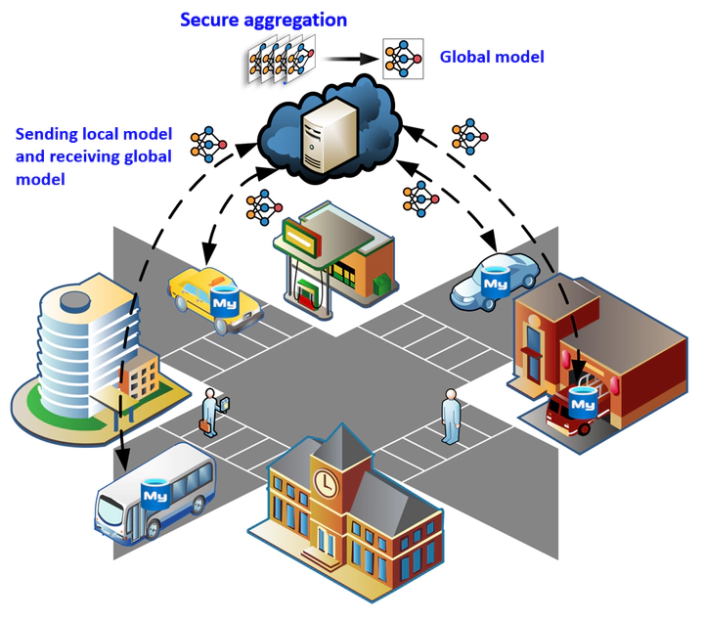
FEDERATED LEARNING APPLICATION

Slide 28
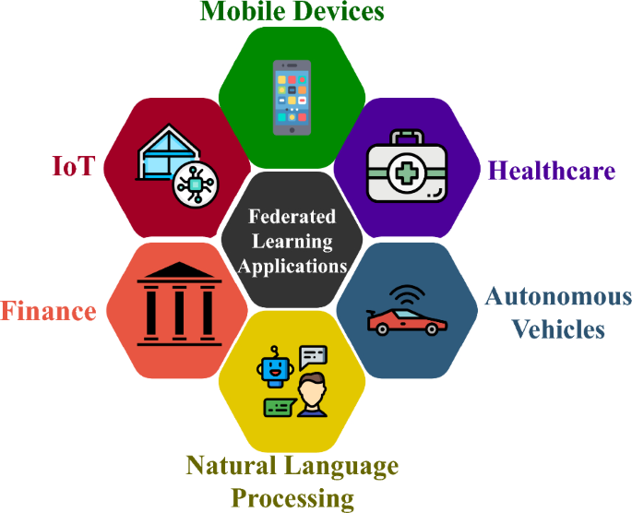

Slide 29
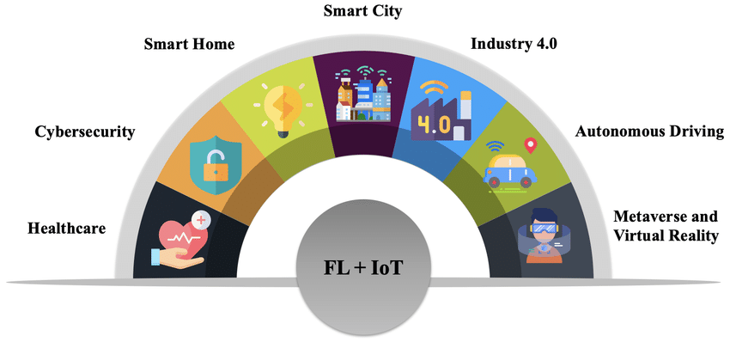
Federated Learning In IoT

Slide 30
How FL Works in IoT
Each IoT device trains a local model on its own data.
It sends only the encrypted updates (not raw data) to the cloud/server.
The server aggregates updates from many devices into a global model.
The improved model is sent back to all devices.
The process repeats to improve the model iteratively.

Slide 31
FL For IoT Services
1. FL as an Alternative to IoT Data Sharing
Problem: Traditional IoT systems rely on centralized servers, which require uploading raw user/device data — raising privacy and bandwidth concerns.
FL Role: Enables on-device training of AI models without sending raw data to the cloud.
Benefit: Preserves data privacy, reduces communication overhead, and enables regulatory compliance (e.g., GDPR).
2. FL for Optimization of IoT Data Offloading and Caching
Problem: Network congestion and delay due to massive IoT data traffic and dynamic content demands.
FL Role: Trains models to predict user content needs and offloading decisions collaboratively at the edge.
Benefit: Enhances cache efficiency, reduces latency, and improves QoS (Quality of Service).
3. FL for IoT Attack Detection
Problem: Centralized models are vulnerable to network attacks (e.g., DDoS, malware) and are slow to adapt to local threats.
FL Role: Devices locally train models on network behavior to detect anomalies and share updates.
Benefit: Enables real-time, distributed intrusion detection with improved privacy and response time.
4. FL for IoT Localization
Problem: Indoor and outdoor localization systems face challenges due to signal noise and privacy concerns.
FL Role: Devices learn location models locally based on Wi-Fi, Bluetooth, or sensor signals.
Benefit: Achieves accurate localization without centralized raw signal sharing, preserving location privacy.
5.Mobile Crowdsensing
Problem: In crowdsensing, multiple users contribute sensory data (e.g., pollution, traffic) — but sharing raw data can expose personal info.
FL Role: Users train local models and share model updates instead of raw sensor data.
Benefit: Enables privacy-aware sensing and efficient aggregation, supporting real-time environmental monitoring.

Slide 32
Experimental Replication of
CloudyFL: A Cloudlet-Based Federated Learning Framework for Sensing User Behavior Using Wearable Devices
-Qingyuan Gong et al .

Slide 33
☁️ What is CloudyFL?
Cloudlet-Based Federated Learning — a framework that uses cloudlets to improve federated learning on wearable devices
A cloudlet is a small data center or server located close to the user/device — like:
A mini-server in your neighborhood
A powerful computer at the edge of the network
A Wi-Fi router with computing ability
Why Cloudlets in CloudyFL?
Problems in Traditional FL:
Wearable devices have limited power & compute → training is slow
Direct communication with cloud server causes latency & congestion
Sharing updates from many devices directly to cloud = scaling issue

Slide 34
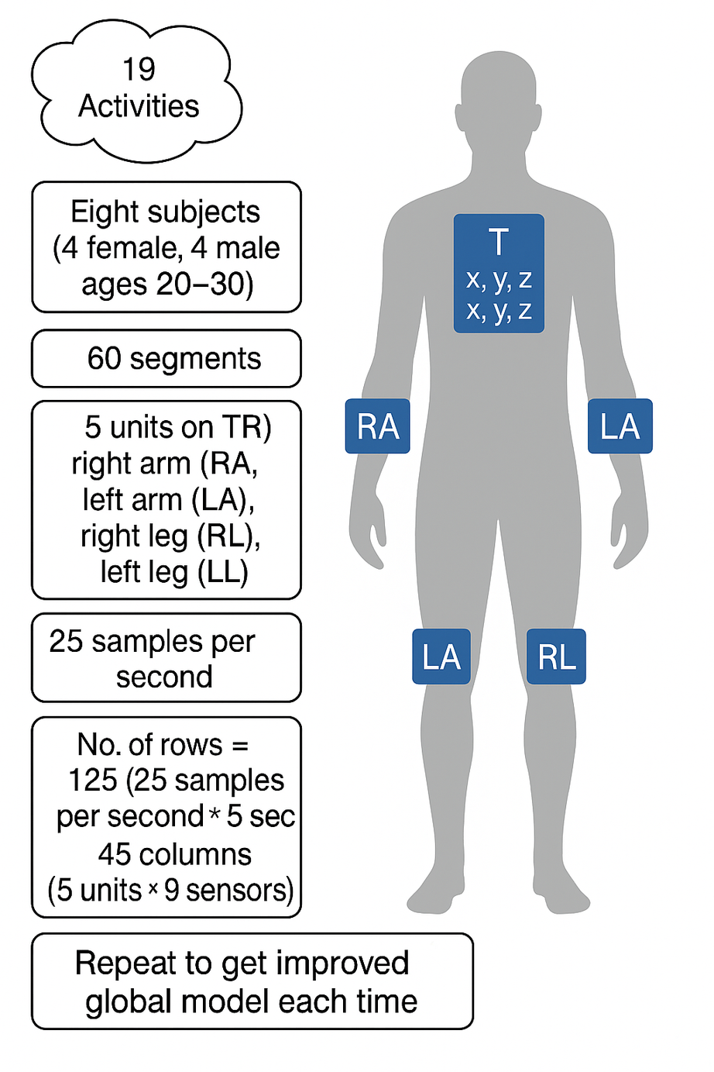
DATASET USED:
Daily and Sports Activities
9 sensors on each unit
x,y,z accelerometers
x,y,z gyroscopes
x,y,z magnetometers

Slide 35
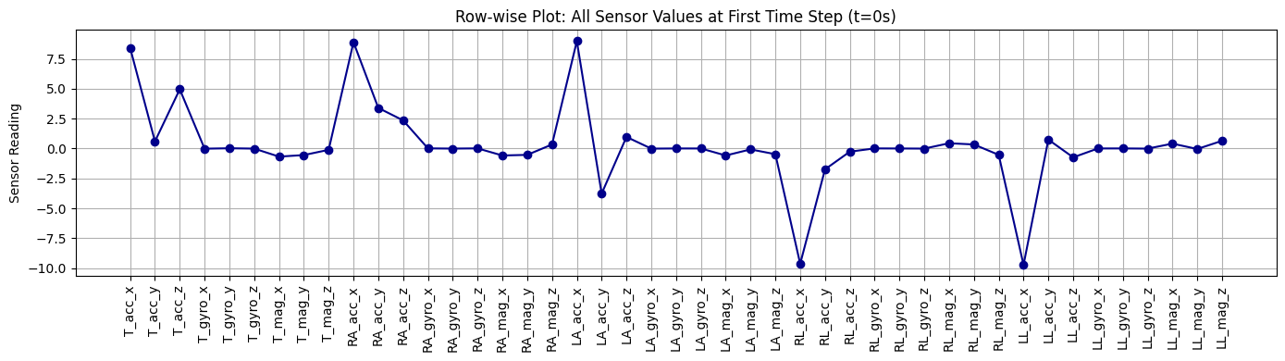
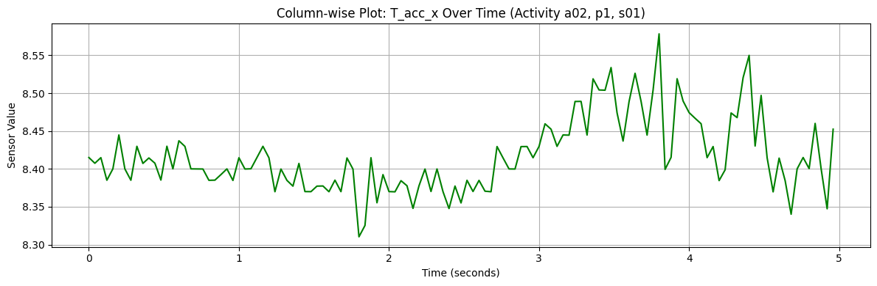

Slide 36
MODELS USED IN EXPERIMENT
Att LSTM
Resricted Softmaxfunction
FedAvg
FedRS

Slide 37
Algorithm: Federated Learning with Bi-LSTM + Attention + Standard Softmax
1.Dataset Preparation
Input: Raw sensor data (UCI HAR), organized per activity and actor.
Process:
Read .txt files from the dataset path.
Each file is reshaped to (125, 45) where:
125 = Time steps.
45 = Sensor features.
Data Shape:
Final tensor shape: X → (N, 125, 45), y → (N,)
→ where N is number of samples.
Normalization:
Apply StandardScaler across feature axis.
Xnorm=X−μ/σ

Slide 38
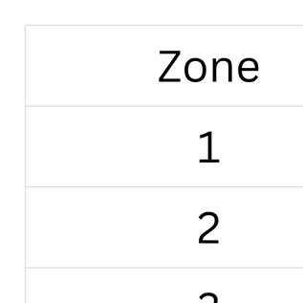
Step 2: Non-IID Zone Creation
Create 5 zones (clients) with actor ranges:

Slide 39
Step 3: LSTM + Attention Model
x∈RB×T×F
Where:
B = batch size
T = 125 (time steps)
F = 45 (features)
1. Bi-directional LSTM
Hidden size: h = 128, so output is:
out∈RB×T×2h=RB×125×256
2. Attention Layer
Applies attention to time steps:
weights=softmax(Wa⋅out)∈RB×T
ctx=∑t=1Tweight⋅out∈RB×256
3. Fully Connected Layer
logits=Wf⋅ctx+b∈RB×C
Where C = number of classes (e.g., 19).
4. Softmax Function:
ŷᵢ = exp(zᵢ) / ∑ⱼ=1ᶜ exp(zⱼ), for i = 1, ..., C
Where:
- zᵢ = the logit (raw output) for class i
- C = total number of classes
- ŷᵢ = predicted probability for class i

Slide 40
Step 4: Training
Loss: Cross-Entropy
L = − ∑ (from i = 1 to C) [ yᵢ * log(ŷᵢ) ]
Where:
- ŷᵢ = predicted probability for class i
- yᵢ = true label (one-hot encoded, i.e., 1 for correct class, 0 otherwise)
- C = total number of classes
Optimizer: Adam
Step5:Send model weight from each cloudlet ---> server
Step 6: Federated Averaging (FedAvg)
Each round:
Each zone trains on its data.
Uploads local weights.
Aggregation:
w_global = (1 / K) * ∑ (from k = 1 to K) w^(k)
Where:
- K = number of clients (or zones)
- w^(k) = local model weights from client k
- w_global = aggregated global model weights
Global model is updated with averaged weights.

Slide 41
Step 7: Send Aggregate Model to Zone
Each cloudlet recieves updated global model
Zone-wise Metrics:
Accuracy, Precision, Recall, F1-score on each zone.
Step8:Repeat Step 4-7
For multiple FL round and improve accuracy
Step9:Compare Global vs local
Step 10:Plot and analyze

Slide 42
OUTPUT:
Final Global Evaluation on Full Dataset:
🔹 Accuracy : 0.8940
🔹 Precision: 0.9175
🔹 Recall : 0.8940
🔹 F1-Score : 0.8872

Slide 43
FEDAvg PIPELINE
Load dataset
Created Trusted Zone
Initialize Attention LSTM Mode for each cloudlet,Restricted Sotmax
Local Training n each cloudlet
Send model weights from each cloudlet to server
FedAvg on server:
Aggregate weight
create global modal
Send aggregated model to zone
Find accuracy, precision, f1 score, recall
Repeat to get improved global model each time

Slide 44
Disadvantages of Using Standard Softmax in Non-IID Settings:
Wrong gradients:
The model still updates weights for classes it has never seen.
That adds noise to the training.
Slow convergence:
Learning takes longer because updates are distracted by irrelevant classe
Unstable training:
Clients may become biased or confused about how to differentiate between many classes they never observed

Slide 45
FedRS
Step 1: Data Preparation
Step2:Create Zones
Step3:LSTM + Attention + Restricted Softmax
Input: x ∈ ℝ^{B×125×45}
Apply 2-layer Bi-LSTM (hidden size h = 128):
out ∈ ℝ^{B×125×256}
Compute attention weights:
w = softmax(Wₐ · out) ∈ ℝ^{B×125×1}
Compute context vector:
ctx = Σ_{t=1}^{T} (wₜ · outₜ) ∈ ℝ^{B×256}
Fully Connected Layer:
logits = W_f · ctx + b ∈ ℝ^{B×C}

Slide 46
Apply Restricted Softmax:
Select top-k logits (default: k=5)
Apply softmax with temperature α to only those top-k
Final output: probability over restricted class set
softmax(z_i) = exp(z_i / α) / sum_j [exp(z_j / α)]
logits = [6.2, 3.6, 2.5]
softmax ≈ [0.87, 0.09, 0.04]
With α = 0.9:
logits / 0.9 = [6.89, 4.00, 2.78]
softmax ≈ [0.91, 0.06, 0.03]

Slide 47
Step4:Local Training (Client-Side)
For each client/zone k = 1 to K:
Initialize local model M_k with global weights w_global.
Train M_k on local data (zone_k) for E epochs using:
Cross-Entropy Loss:
L = - ∑_{i=1}^{C} yᵢ * log(ŷᵢ)
Where:
- L = Loss
- C = total number of classes
- yᵢ = ground truth (1 if true class, 0 otherwise)
- ŷᵢ = predicted probability for class i (from softmax)

Slide 48
Step 4: Model Aggregation (FedAvg)
Collect local weights:
w(1),w(2),…,w(K)
Aggregate using Federated Averaging:
w_global = (1 / K) * ∑_{k=1}^{K} w^(k)
Where:
K = number of clients
w^(k) = weights from client k
w_global = averaged global weights
Update global model with wglobal

Slide 49
Step 7: Send Aggregate Model to Zone
Each cloudlet recieves updated global model
Zone-wise Metrics:
Accuracy, Precision, Recall, F1-score on each zone.
Step8:Repeat Step 4-7
For multiple FL round and improve accuracy
Step9:Compare Global vs local
Step 10:Plot and analyze

Slide 50
OUTPUT:
Final Global Evaluation on Full Dataset:
🔹 Accuracy : 0.8973
🔹 Precision: 0.9144
🔹 Recall : 0.8973
🔹 F1-Score : 0.8944

Slide 51
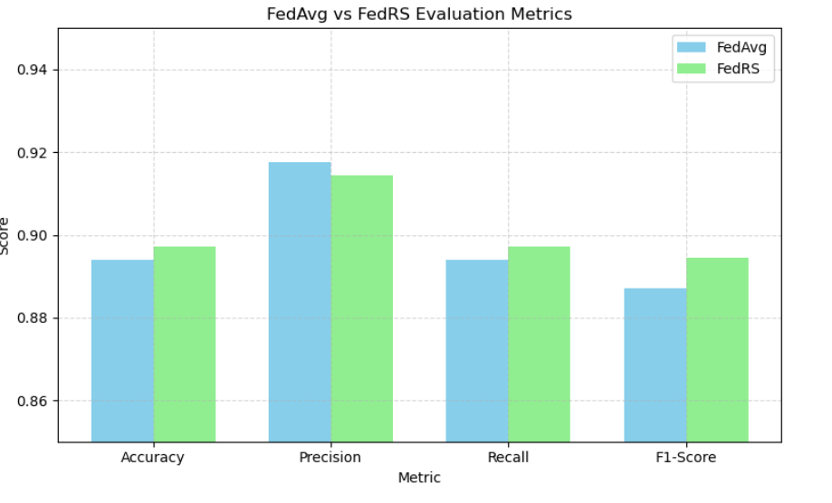

Slide 52
why not FedRS
1.Biased Toward Local Classes
Focuses only on classes present in the local client.
Poor generalization to global/unseen classes.
2. Overfitting Risk
High accuracy on local data, but low global performance due to over-specialization.
3. Reduced Class Discrimination
Ignores global class relationships → weaker inter-class learning.
4. Aggregation Issues
Different class distributions lead to inconsistent logits across clients.
5. Requires Careful Hyperparameter Tuning
Parameters like softmax temperature/restriction thresholds are sensitive.
6. Not Suitable for Dynamic Class Environments
Performs poorly when client class distributions change over time (e.g., IoT/streaming).
7.No Built-in Privacy
Does not inherently protect data privacy — must be combined with DP or secure aggregation.

Slide 53
Thank You

